Slide 1




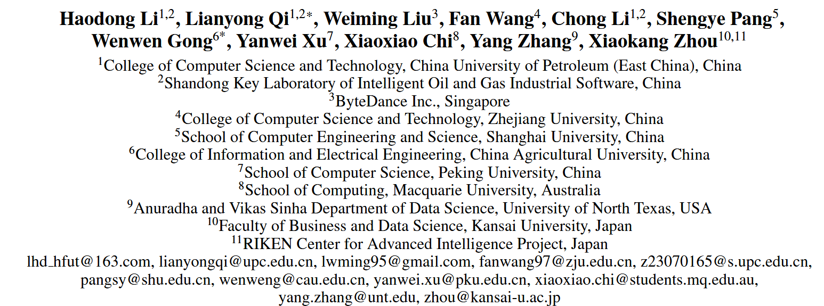



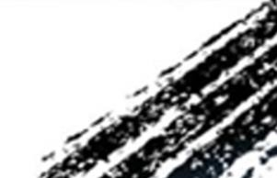

ATAI
Advanced Technique of Artificial Intelligence
ATAI
ChongqingUniversity _{AdvancedTechniqueof}
of Technology Artificial Intelligence
Chongqing University of
Technology
Chongqing University ^{ATAI}
_{of Technology} Advanced Techniqueof
Artificial Intelligence
Chongqing University of Technology
Chongqing University of Technology
Subspace-Aware Graph Construction and Contrastive Alignment
for Multimodal Recommendation with Large Language Models
Code : None
——AAAI_2026
Reported by Yuhang Jang
1

Slide 2
ATAI
Advanced Technique of Artificial Intelligence
ATAI
ChongqingUniversity _{AdvancedTechniqueof}
of Technology Artificial Intelligence
Chongqing University of
Technology
Chongqing University ^{ATAI}
_{of Technology} Advanced Techniqueof
Artificial Intelligence
Chongqing University of Technology
Chongqing University of Technology
Motivation
1)Existing studies on multimodal recommendation primarily focus on constructing item-item semantic graphs. However, most of these methods capture only shallow semantic structures based on feature similarity and struggle to model more complex or cross-entity semantic relationships (e.g., user-item).

Slide 3
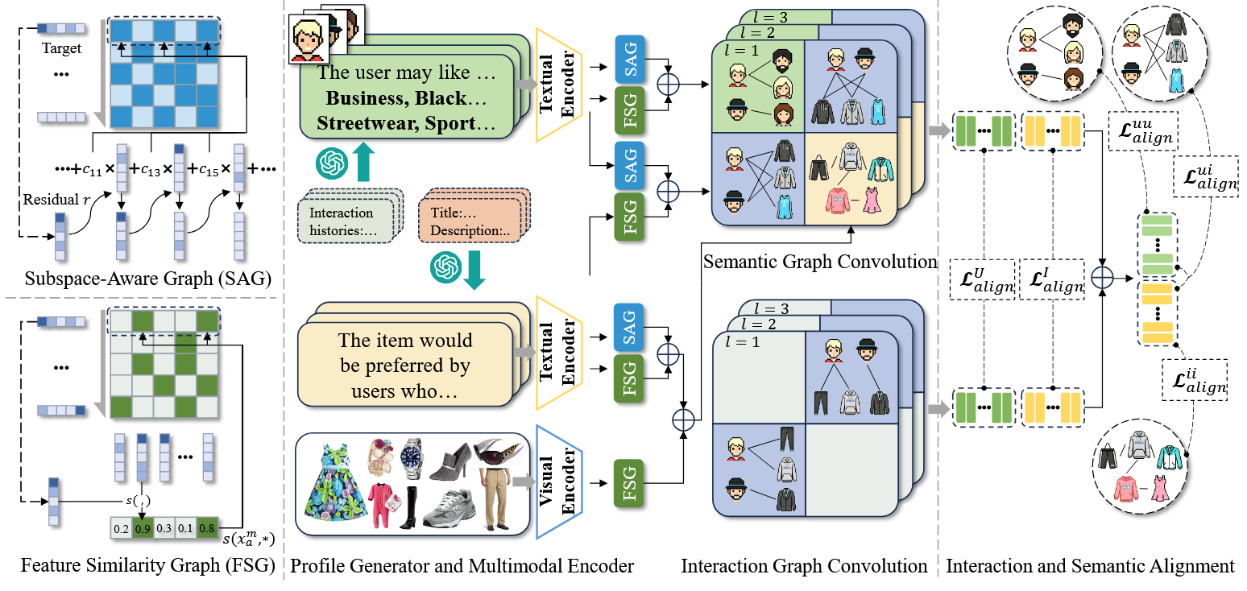
ATAI
Advanced Technique of Artificial Intelligence
ATAI
ChongqingUniversity _{AdvancedTechniqueof}
of Technology Artificial Intelligence
Chongqing University of
Technology
Chongqing University ^{ATAI}
_{of Technology} Advanced Techniqueof
Artificial Intelligence
Chongqing University of Technology
Chongqing University of Technology
Method

Slide 4
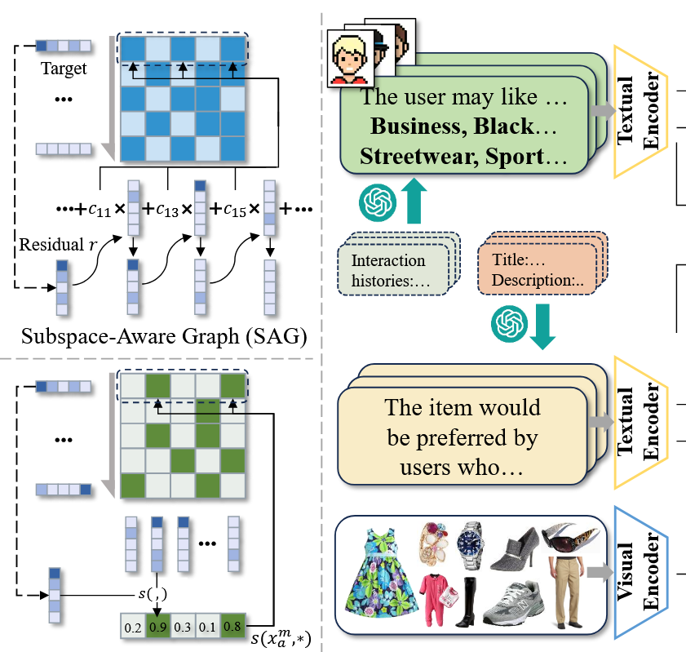





ATAI
Advanced Technique of Artificial Intelligence
ATAI
ChongqingUniversity _{AdvancedTechniqueof}
of Technology Artificial Intelligence
Chongqing University of
Technology
Chongqing University ^{ATAI}
_{of Technology} Advanced Techniqueof
Artificial Intelligence
Chongqing University of Technology
Chongqing University of Technology
Method

Slide 5
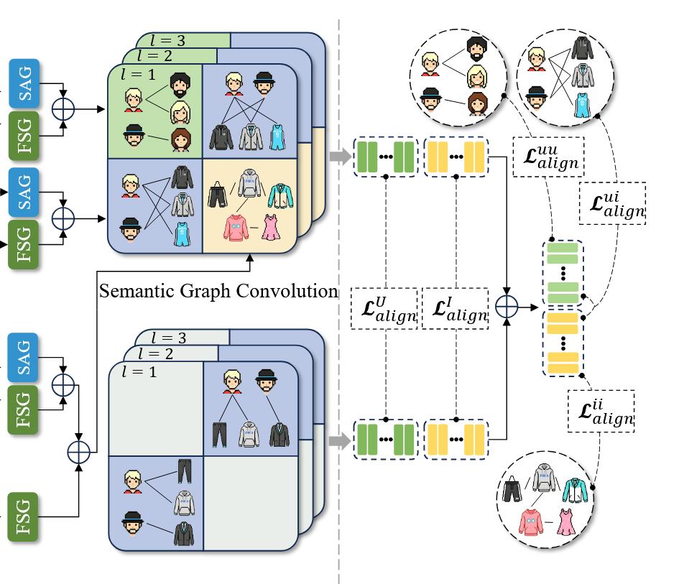
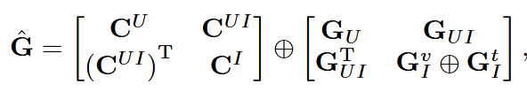

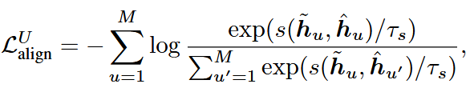

ATAI
Advanced Technique of Artificial Intelligence
ATAI
ChongqingUniversity _{AdvancedTechniqueof}
of Technology Artificial Intelligence
Chongqing University of
Technology
Chongqing University ^{ATAI}
_{of Technology} Advanced Techniqueof
Artificial Intelligence
Chongqing University of Technology
Chongqing University of Technology
Method

Slide 6




ATAI
Advanced Technique of Artificial Intelligence
ATAI
ChongqingUniversity _{AdvancedTechniqueof}
of Technology Artificial Intelligence
Chongqing University of
Technology
Chongqing University ^{ATAI}
_{of Technology} Advanced Techniqueof
Artificial Intelligence
Chongqing University of Technology
Chongqing University of Technology
Method

Slide 7

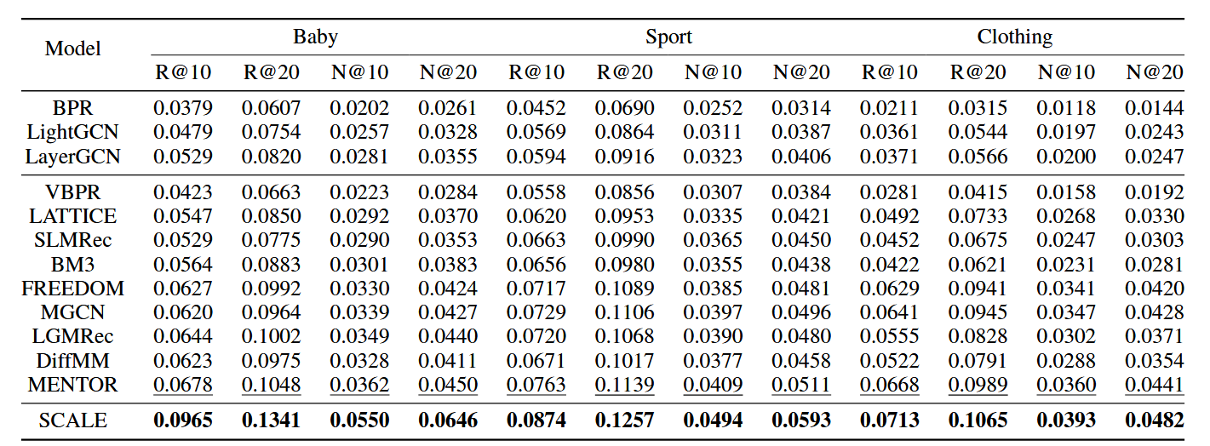
ATAI
Advanced Technique of Artificial Intelligence
ATAI
ChongqingUniversity _{AdvancedTechniqueof}
of Technology Artificial Intelligence
Chongqing University of
Technology
Chongqing University ^{ATAI}
_{of Technology} Advanced Techniqueof
Artificial Intelligence
Chongqing University of Technology
Chongqing University of Technology

Slide 8
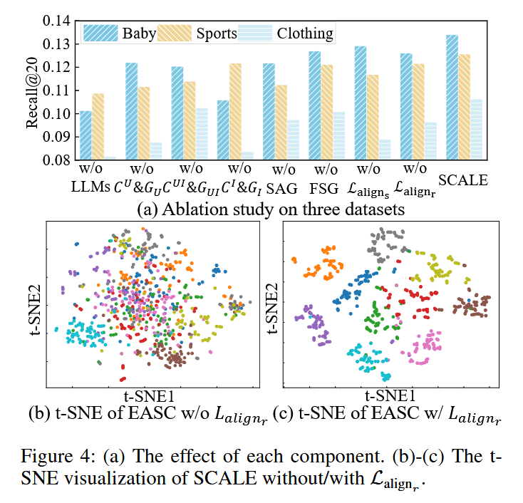
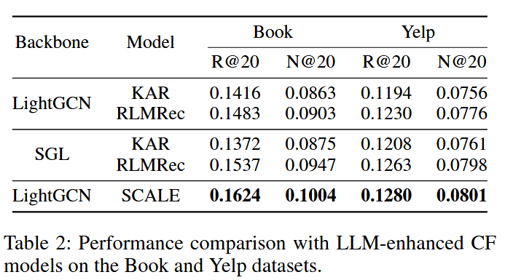
ATAI
Advanced Technique of Artificial Intelligence
ATAI
ChongqingUniversity _{AdvancedTechniqueof}
of Technology Artificial Intelligence
Chongqing University of
Technology
Chongqing University ^{ATAI}
_{of Technology} Advanced Techniqueof
Artificial Intelligence
Chongqing University of Technology
Chongqing University of Technology

Slide 9
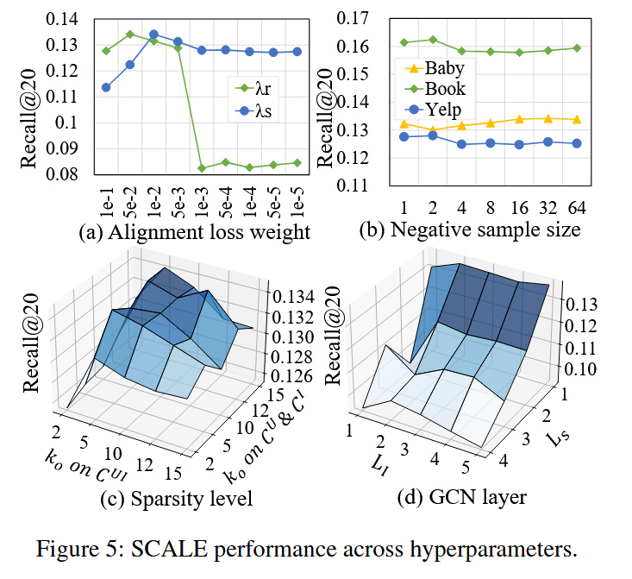
ATAI
Advanced Technique of Artificial Intelligence
ATAI
ChongqingUniversity _{AdvancedTechniqueof}
of Technology Artificial Intelligence
Chongqing University of
Technology
Chongqing University ^{ATAI}
_{of Technology} Advanced Techniqueof
Artificial Intelligence
Chongqing University of Technology
Chongqing University of Technology

Slide 10


ATAI
Advanced Technique of Artificial Intelligence
ATAI
ChongqingUniversity _{AdvancedTechniqueof}
of Technology Artificial Intelligence
Chongqing University of
Technology
Chongqing University ^{ATAI}
_{of Technology} Advanced Techniqueof
Artificial Intelligence
Chongqing University of Technology
Chongqing University of Technology
Thanks!

